Slide 1

AUTOMATIC NUMBER PLATE DETECTION
TEAM MEMBERS
D.KARTHIK -21311A6916
B.NAVEEN -21311A6933
N.HARIKA -21311A6960
INTERNAL GUIDE
K.SIVA KUMAR GOWDA
ASSISTANT PROFESSOR
CSE-IOT

Slide 2
ABSTRACT
This project presents an automatic number plate detection system using YOLO (You Only Look Once) and the Easy OCR library.
YOLO provides real-time object detection, identifying number plates with high accuracy. Easy OCR, a robust optical character recognition tool, extracts text from the detected plates.
The integration of these technologies results in a fast, efficient, and reliable solution for number plate recognition, enhancing traffic management and law enforcement capabilities.

Slide 3
INTRODUCTION
This project introduces an Automatic Number Plate Detection system utilizing YOLO for real-time object detection and Easy OCR for text extraction.
YOLO rapidly identifies number plates in video frames, while Easy OCR accurately reads the characters. This integration results in a seamless, efficient process for recognizing vehicle plates.
The system offers advantages like enhanced traffic management, improved law enforcement efficiency, and reduced human error, making it a valuable tool for urban infrastructure.

Slide 4
PREPARE THE DATASET
Data Collection:
Collect a diverse set of images containing vehicle number plates from various sources and conditions.
Data Cleaning:
Remove duplicates, corrupt files, and irrelevant images to ensure high-quality data for training.
Annotation:
Use tools like LabelImg to manually draw bounding boxes around the number plates in the images.
Annotation Format:
Save annotations in YOLO format (text files with bounding box coordinates) to ensure compatibility with YOLOv5.
Data Splitting:
Split the dataset into training (70%), validation (15%), and test (15%) sets to evaluate the model's performance properly.
Directory Organization:
Organize the dataset into appropriate directories for easy access during the training process.

Slide 5
FEATURE ENGINEERING
Resizing:
Resize all images to a consistent size (e.g., 416x416 pixels) to match the input requirements of the YOLO model.
Normalization:
Normalize pixel values to a range (e.g., 0 to 1) to improve the model's convergence and performance.
Data Augmentation:
Apply data augmentation techniques such as rotation, flipping, and brightness adjustments to increase data diversity and robustness.
Tools for Augmentation:
Use libraries like Augmentor to automate and standardize the data augmentation process.
Save Processed Data:
Save the augmented images in the training directory to ensure they are used during the training phase.
Augmentation Benefits:
Augmentation helps the model generalize better by exposing it to various transformations of the original images.

Slide 6
CHOOSE A MODEL AND ALGORITHM
Model Selection:
Choose YOLO (You Only Look Once) for real-time object detection due to its speed and accuracy.
YOLOv5 Setup:
Clone the YOLOv5 repository and install necessary dependencies to set up the training environment.
Configuration:
Configure the YOLOv5 model with the dataset paths and number of classes (e.g.,number plate).
Training YOLOv5:
Train the YOLOv5 model using the prepared and annotated dataset to detect number plates in images.
Easy OCR Integration:
Install Easy OCR for optical character recognition (OCR) to read text from the detected number plates.
Combining Models:
Use YOLOv5 for detecting number plates and EasyOCR for reading the detected text, providing an end-to-end ANPR solution.

Slide 7
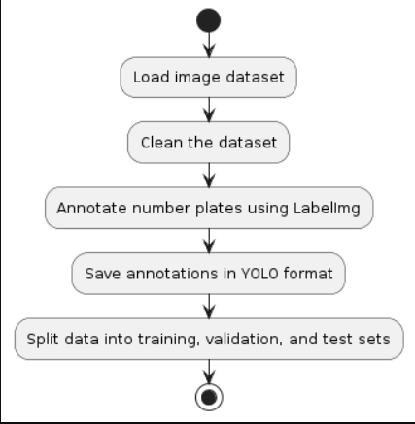
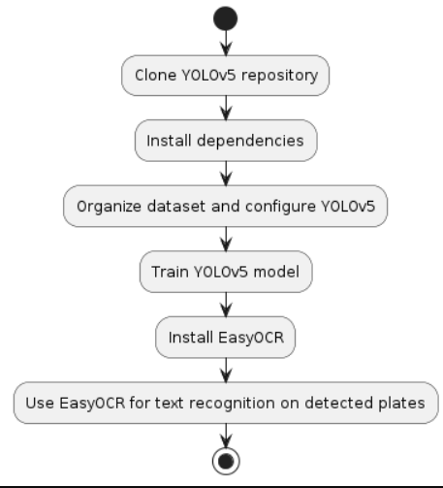
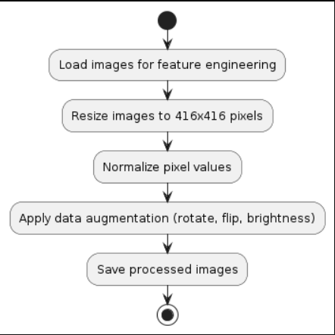

Slide 8
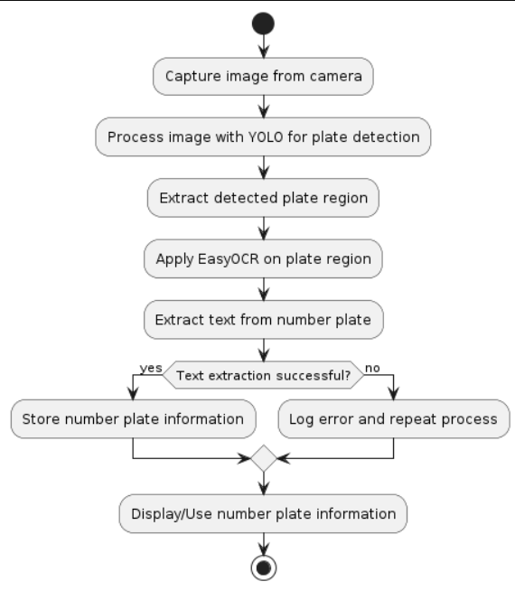
ACTIVITY DIAGRAM

Slide 9
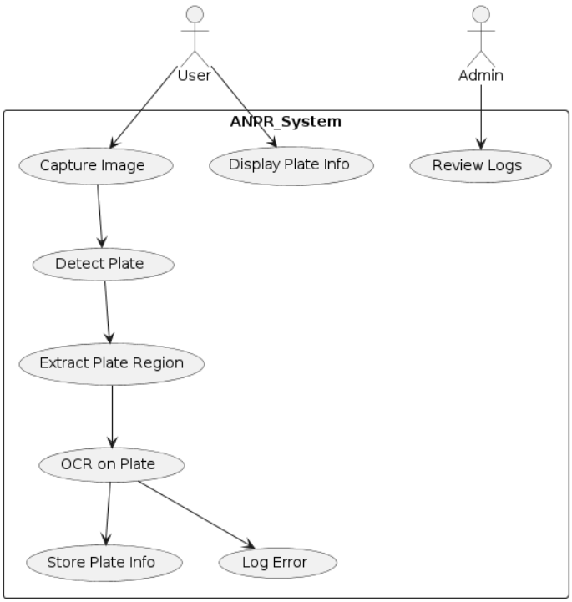
USECASE DIAGRAM

Slide 10
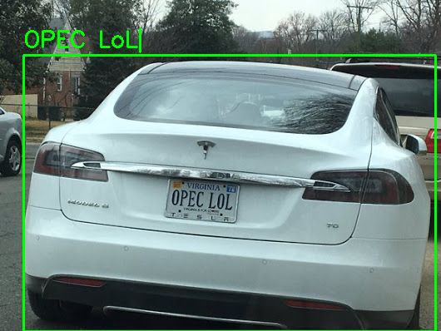
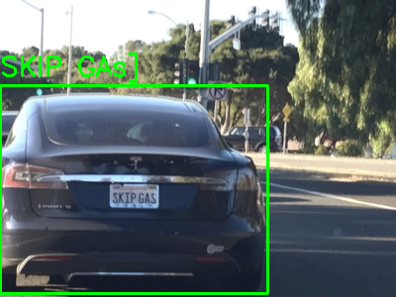
TEST RESULTS USING THE MODEL

Slide 11
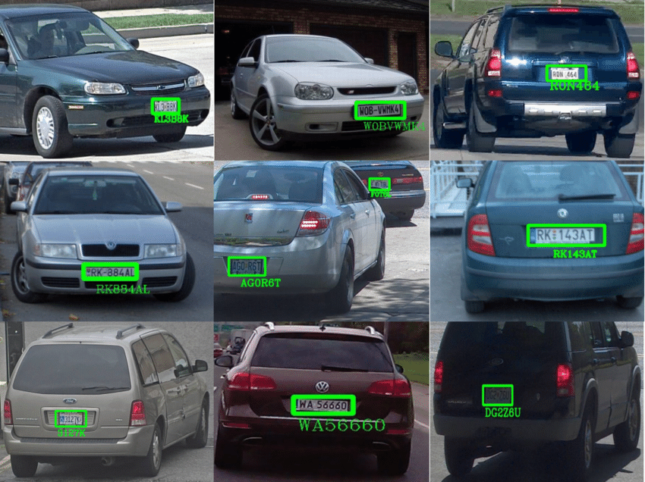

Slide 12
HARDWARE AND SOFTWARE REQUIREMENTS
Software Requirements
Python (3.7 or later)
OpenCV (cv2)
Easy OCR
YOLOv5
CUDA (for GPU acceleration)
An Integrated Development Environment (IDE) like PyCharm, VSCode, or Jupyter Notebook
Hardware Requirements
Computer with a modern CPU
At least 8GB RAM
Storage: At least 10GB free space for software and dependencies
GPU: NVIDIA GPU with CUDA support (strongly recommended for faster processing)
Webcam or USB camera (if you want to process live video)

Slide 13
CONCLUSION
This project implements an automated license plate detection and recognition system using computer vision and machine learning. It combines YOLOv5 for object detection and Easy OCR for text recognition, processing both images and videos.
The system detects license plates in visual media, extracts the plate text, and overlays the results on the original input. This solution has potential applications in traffic management, parking systems, and law enforcement, offering an efficient way to automate vehicle identification tasks.

Slide 14
REFERENCES
1. Redmon, J., Divvala, S., Girshick, R., & Farhadi, A. (2016). You Only Look Once: Unified, Real-Time Object Detection. In Proceedings of the IEEE Conference on Computer Vision and Pattern Recognition (CVPR) (pp. 779-788).
2. Redmon, J., & Farhadi, A. (2018). YOLOv3: An Incremental Improvement. arXiv preprint arXiv:1804.02767.
3. Jocher, G., et al. (2021). ultralytics/yolov5: v6.0 - YOLOv5n 'Nano' models, Roboflow integration, TensorFlow export, OpenCV DNN support. Zenodo. https://doi.org/10.5281/zenodo.5563715
4. Jaided AI. (2020). EasyOCR. GitHub repository. https://github.com/JaidedAI/EasyOCR
5. Bradski, G. (2000). The OpenCV Library. Dr. Dobb's Journal of Software Tools.

Slide 15
THANK YOU

